Slide 1

Team Name : InfraX
Team Leader Name : Chirag Keswani
Problem Statement : Design an AI-driven solution that helps create, manage,
personalize, or distribute digital content more effectively.

Slide 2

Brief about the Idea:
AI is an intelligent pre-posting assistant that predicts potential hate, trolling, or backlash before content is published on social media.
The system analyzes captions, text, images, or videos using AI models to detect:
toxicity
sensitive topics
aggressive tone
audience reaction risk
It provides early warnings and smart suggestions so creators can post safer and smarter content.
This transforms social media posting from reactive moderation → proactive prevention.

Slide 3
Differentiation + Solution + USP
How different is it from existing tools?
Current tools remove hate after posting
Block/report system only after damage
No risk prediction available
How will it solve the problem?
Analyzes content before publishing
Predicts backlash probability
Detects toxic or sensitive words
Suggests safer alternatives
USP of the proposed solution
Pre-post backlash prediction
AI audience simulation
Real-time tone correction
Backlash risk meter

Slide 4
List of Features Offered
Features
Content sentiment analysis
Toxicity & hate speech detection
Sensitive topic identification
Backlash probability scoring (%)
Toxic word highlighter
AI tone rewriting suggestions
Audience reaction simulation
Dashboard with risk meter
Multi-language support

Slide 5
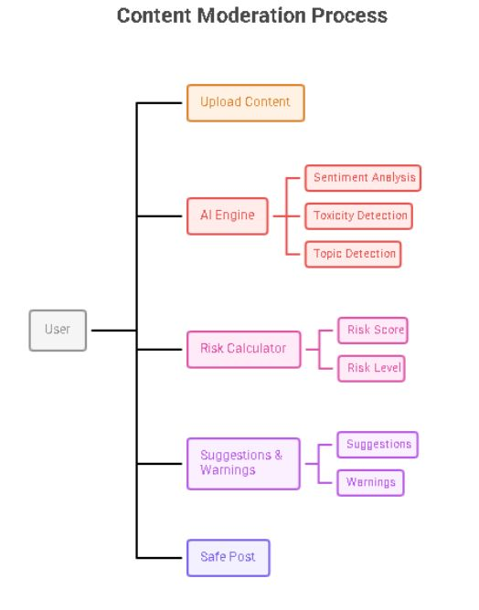
System Flow
User uploads content (text/image/video)
System captures input
Backend API sends data to AI engine
AI analyzes sentiment, toxicity, and topics
Risk engine calculates backlash score
Suggestions and warnings displayed
User edits → posts safely
Flow:
User → Upload → AI Engine → Risk Analysis → Suggestions → Safe Post

Slide 6
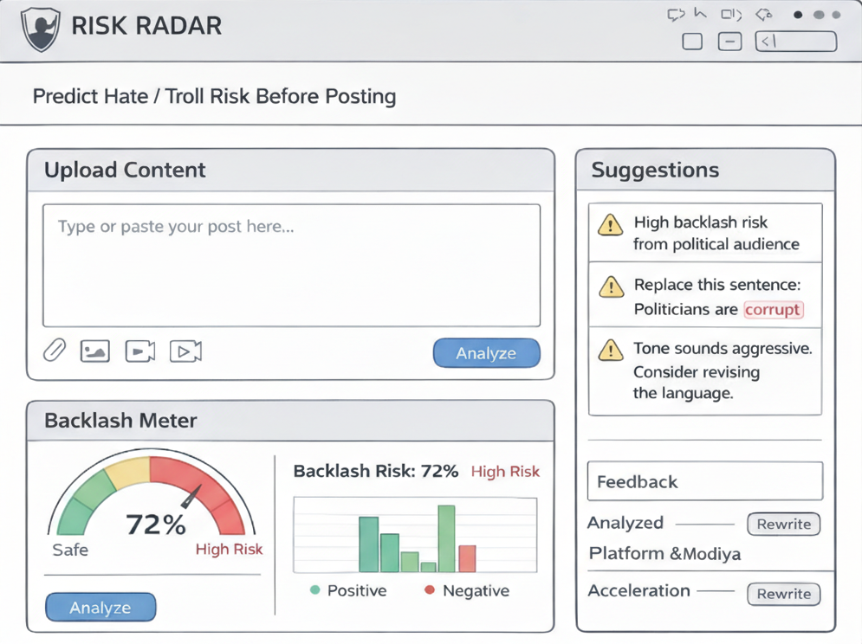
Wireframes/Mock diagrams of the proposed solution
Interface will include:
Content upload panel
Highlighted toxic words
Backlash meter (Green/Yellow/Red gauge)
Sentiment graph
Suggested rewritten sentences
Risk summary dashboard
Design goal:
Simple, clean, and non-intrusive user experience.

Slide 7
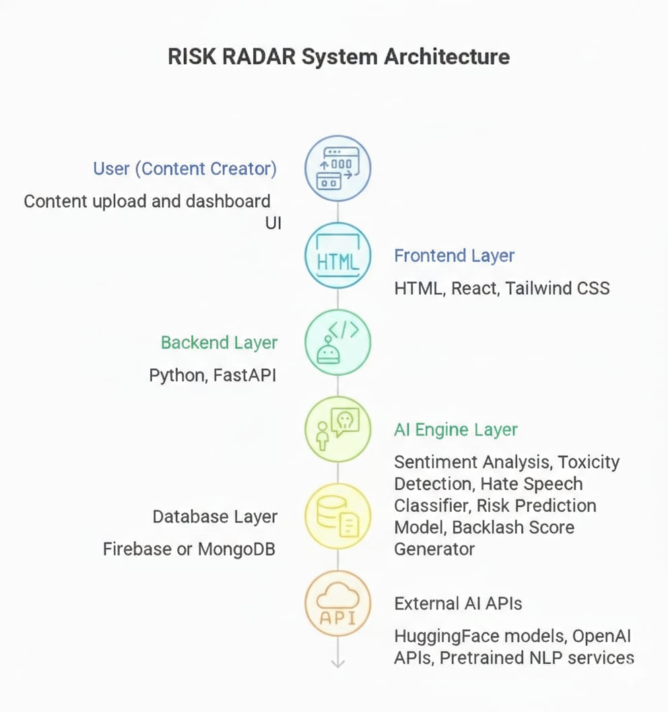
Architecture Diagram of the Proposed Solution
Frontend
HTML , React , Tailwind CSS
Backend
Python (FastAPI)
API handling & processing
AI Layer
Sentiment Analysis Model
Toxicity Detection Model
Hate Speech Classifier
NLP Transformer Models
Database
MongoDB / Firebase
System Flow
Frontend → Backend API → AI Engine → Results → Dashboard

Slide 8
Technologies to be used in the solution:
Tech Stack
Python
HTML , React , Tailwind CSS
AI/ML (libraries of python)
NLP & Transformers (BERT/LLMs)
Sentiment Analysis Libraries
HuggingFace / OpenAI APIs
MongoDB / Firebase
Chart.js / D3.js
Cloud Hosting (AWS/GCP/Azure)

Slide 9
Estimated implementation cost :
Cost Estimation
Core technologies: Open-source (Free)
Hosting: Low cost cloud services
APIs: Scalable usage-based pricing
Development: Student-friendly budget
Result:
Prototype can be built with minimal cost.

Slide 10
Expected Impact & Future Scope
Expected Impact
Reduced online hate
Safer content creation
Mental health protection for creators
Improved brand reputation
Better audience engagement
Responsible digital communication
Future Scope
Instagram/Twitter integration
Browser extension
Real-time posting assistant
Meme & image sarcasm detection
Multilingual hate detection
Live audience analytics

Slide 11


